Slide 1
March 2021
MT&I Training: Interaction Studio
Notes:
Kalpana

Slide 2






Instructors and Sponsors
Special Shoutout:
Thanks to Cara Thomas, Xing Liang, and Adeolu Adesanya for helping with the training material!
INTRO
Session Leads
Kalpana Satish
Consultant
Meredith Maney
Consultant
Akshay Kashyap
Consultant
Sponsors
Corey Inouye
Senior Manager
Nick Ingham
Senior Manager
Syed Mir
Senior Manager
Notes:
Kalpana

Slide 3
Table of Contents
INTRO
Below are agenda items for day 1 and day 2 of the Interaction Studio training.
DAY 1
DAY 2
Interaction Studio Overview
5
Use Case Example Overview
24
Use Cases
8
Discovery
15
Platform Setup
25
Roadmap
16
17
Offerings
Activation
37
Pricing & Packaging
18
Timeline & Team
19
Leading Practices & Resources
44
Competitive Differentiators
21
Notes:
Kalpana

Slide 4

Day 1:
Platform and Implementation Overview

Slide 5

How we see Personalization via Interaction Studio
Day 1
The Interaction Studio product couples customer data, with decisioning, to distribute offers across multiple channels.
DATA
DECISIONING & ANALYTICS
DELIVERY: CONTENT AND CHANNELS
Unified Data Foundation
Machine Learning & AI
Offer Delivery
Simplified single point for the entire experience ecosystem
Advanced predictive capabilities empowering data-driven decisioning
Leverage real-time customer profiles to deliver the right personalized offer to maximize revenue
Unified View Of Customer
Customer Journey Insights
Journey Orchestration
Unified profile customer data across channels
Speed to insights using customer journey analytics to identify opportunities
Behavior-triggered journeys and campaigns
Segmentation
Offer Decisioning
Personalization & Testing
Dynamic segments that solve scalability problems marketers traditionally face when building segments off both real time and batch data.
Leverage real-time customer profile to optimize the right personalized offer to maximize revenue
Activate dynamic segments created to preferred destinations that can optimized with A/B/n testing
https://share.vidyard.com/watch/iG1o8nxsSPzZcLsijXGF7X?
Notes:
Kalpana

Slide 6
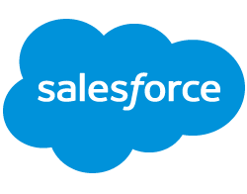

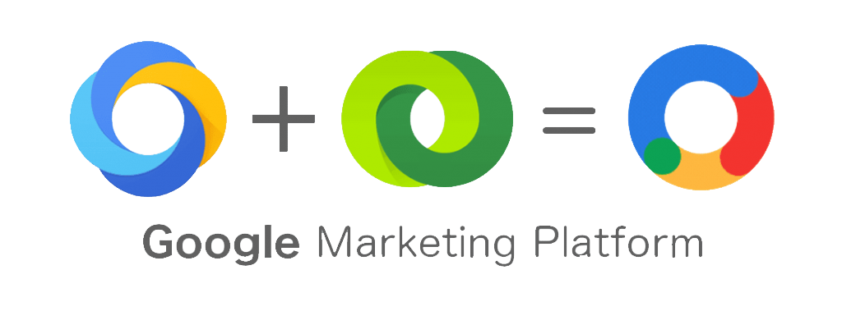

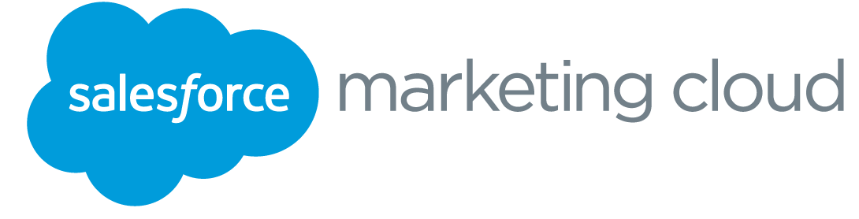
How Interaction Studio Fits Into Salesforce Stack
Day 1
Salesforce Interaction Studio works alongside other Salesforce products with the focus in web and email personalization / optimization.
DATA
DECISIONING & ANALYTICS
DELIVERY: CONTENT AND CHANNELS
DATA SOURCES
2
CONTENT PERSONALIZATION & OPTIMIZATION
Web Personalization & Optimization
Web
Email Engagement
Interaction Studio 2.0
TAGGING
5
EMAIL ACTIVATION
Newsletter Signups & Email Preferences
Email Personalization & Optimization
Marketing Emails
Tag Manager
Call Center Cases
UNIFY DATA
SEGMENTATION & AUDIENCES
Email Studio
Transact. Emails
Online Behavior
1
OMNI-CHANNEL ORCHESTRATION
6
PAID ADVERTISING ACTIVATION
Customer 360 Audiences
4
Display
Product Info & Reviews
Search
Loyalty &
Subscriptions
MEASUREMENT & INSIGHTS
PRODUCT PERSONALIZATION
Advertising Studio
Paid Social
3
Journey Builder
eCommerce Accounts, Promos & Orders
7
MOBILE ACTIVATION
Datorama
SMS
Einstein Recommendations
(Personalization Builder)
Mobile Studio
Mobile Apps
Notes:
Kalpana

Slide 7


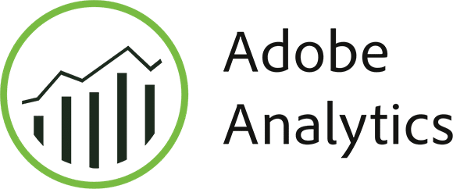
How We Understand Interaction Studio Within Your Architecture
Day 1
Data layer centric approach allows Interaction Studio and Google Analytics to work together measure and optimize the real-time experiences.
DATA
DECISIONING & ANALYTICS
DELIVERY: CONTENT AND CHANNELS
interaction studio
Sales/service cloud
Web/Mobile Campaigns
MOBILE APP ENGAGEMENT DATA
Realtime Segmentation (including control | A/B testing)
Einstein Recipes (AI)
marketing cloud
Reporting
Identity Stitching
marketing cloud
customer 360 audiences / CDP
DATA LAYER
Catalog
Customer Profile
Browsing Events
Search terms
WEBSITE + ECOMMERCE PLATFORM
MOBILE APPLICATIONS
WEBSITE + ECOMMERCE DATA
CLOSED FEEDBACK LOOP: INSIGHTS AND OPTIMIZATION
Notes:
Syed

Slide 8
Key Use Cases Across Various Industries
Day 1
Example web and email use cases across various industries
Retail | Life Sciences | Financial Services | Technology, Media, & Entertainment | Consumer & Industrial Products
Einstein 1:1 Product Recommendations Real-time recommendations will update to reflect products each user is most interested in. | Optimize the HCP Engagement Experience Support and engage HCPs by encouraging them to request more information from the website to drive web personalization. | Customer Onboarding and Build Relationships Remind first time customers of the things they need to do and the actions they need to take to get started with your solution. | Reduce Call Center Volume During Onboarding Connect the digital and service channels together and personalize the web experience based on the web and customer data. | Generate Demand by Preventing Bounce Provide a web popup or other engagement point to segments based on visitors who are on the site for the first time.
Retarget Customers to Encourage a Purchase Present personalized calls to action and email content. | Optimize the Enrollment Experience Ensure urgent messages are seen by managing saturation limits and prioritizing journeys. | Optimize the Digital to In-Person Conversation Understand the customer intent by listening to their activity on the website and mobile, to place them in the most appropriate journey. | Deliver a Consistent Message Across Channels Understand and know intent, need, and preference in real-time, ensuring relevant and timely communications are being sent. | Capture Emails to Create Long-Term Relationships Qualify leads first by only asking for email address from visitors who are engaging with content.
WEB
EMAIL
https://doc.evergage.com/display/EKB/Web+Use+Case+Library
Notes:
Meredith

Slide 9
Interaction Studio Use Case Framework
Applicable Industries
Key Use Cases
DAY 1
INTERACTION CAPTURE
INPUTS
ACTIONS
Interaction Capture
Campaign Orchestration
Journey Injection
Web Personalization
Capture real-time channel interactions across lifecycle
Examples: Product/Category page View, Page/Application abandonment, Profile change event, App interaction
Deploy campaigns across multiple channels to build a connected customer experience
Realtime journey injection from interaction-based segments
Personalized content across different sites
Journey Activity Interaction
Identity Matching
Journey Decisioning
Next Best Action
Journey activity as input towards dynamic segments for site personalization
Map anonymous interactions to gain insight about customer behaviors
Realtime interaction based decisioning for journeys
Personalized recommendations across different sites
Action Center Interactions
Real-Time Segmentation
Action Center Insights
AD/Sales team gets power to create dynamic segments for site personalization
Progressive profiling powered by real-time interactions
Point & click segmentation rules based on aggregation of interactions & profile
Bring contact/lead interaction summary to AD/Sales
Notes:
Kalpana

Slide 10
Anonymous Personalization via Identity Management
All
All
DAY 1
INTERACTION CAPTURE
INPUTS
ACTIONS
Interaction Capture
Campaign Orchestration
Journey Injection
Web Personalization
Capture real-time channel interactions across lifecycle
Examples: Product/Category page View, Page/Application abandonment, Profile change event, App interaction
Deploy campaigns across multiple channels to build a connected customer experience
Realtime journey injection from interaction-based segments
Personalized content across different sites
Journey Activity Interaction
Identity Matching
Journey Decisioning
Next Best Action
Journey activity as input towards dynamic segments for site personalization
Map anonymous interactions to gain insight about customer behaviors
Realtime interaction based decisioning for journeys
Personalized recommendations across different sites
Action Center Interactions
Real-Time Segmentation
Action Center Insights
AD/Sales team gets power to create dynamic segments for site personalization
Progressive profiling powered by real-time interactions
Point & click segmentation rules based on aggregation of interactions & profile
Bring contact/lead interaction summary to AD/Sales
Notes:
Meredith

Slide 11
Journey Injection from Interaction
All
Retarget Customers to Encourage a Purchase
DAY 1
INTERACTION CAPTURE
INPUTS
ACTIONS
Interaction Capture
Campaign Orchestration
Journey Injection
Web Personalization
Capture real-time channel interactions across lifecycle
Examples: Product/Category page View, Page/Application abandonment, Profile change event, App interaction
Deploy campaigns across multiple channels to build a connected customer experience
Realtime journey injection from interaction-based segments
Personalized content across different sites
Map anonymous interactions to gain insight about customer behaviors
Journey Activity Interaction
Identity Matching
Journey Decisioning
Next Best Action
Journey activity as input towards dynamic segments for site personalization
Map anonymous interactions to gain insight about customer behaviors
Realtime interaction based decisioning for journeys
Personalized recommendations across different sites
Action Center Interactions
Real-Time Segmentation
Action Center Insights
AD/Sales team gets power to create dynamic segments for site personalization
Progressive profiling powered by real-time interactions
Point & click segmentation rules based on aggregation of interactions & profile
Bring contact/lead interaction summary to AD/Sales
Notes:
Kalpana

Slide 12
Journey Interaction Driving Customized Web Personalization
All
Deliver a Consistent Message Across Channels
DAY 1
INTERACTION CAPTURE
INPUTS
ACTIONS
Interaction Capture
Campaign Orchestration
Journey Injection
Web Personalization
Capture real-time channel interactions across lifecycle
Examples: Product/Category page View, Page/Application abandonment, Profile change event, App interaction
Deploy campaigns across multiple channels to build a connected customer experience
Realtime journey injection from interaction-based segments
Personalized content across different sites
Map anonymous interactions to gain insight about customer behaviors
Journey Activity Interaction
Identity Matching
Journey Decisioning
Next Best Action
Journey activity as input towards dynamic segments for site personalization
Map anonymous interactions to gain insight about customer behaviors
Realtime interaction based decisioning for journeys
Personalized recommendations across different sites
Action Center Interactions
Real-Time Segmentation
Action Center Insights
AD/Sales team gets power to create dynamic segments for site personalization
Progressive profiling powered by real-time interactions
Point & click segmentation rules based on aggregation of interactions & profile
Bring contact/lead interaction summary to AD/Sales
Notes:
Meredith

Slide 13
Next Best Action from Customer Support
All
Optimize the Digital to In-Person Conversation
DAY 1
INTERACTION CAPTURE
INPUTS
ACTIONS
Interaction Capture
Campaign Orchestration
Journey Injection
Web Personalization
Capture real-time channel interactions across lifecycle
Examples: Product/Category page View, Page/Application abandonment, Profile change event, App interaction
Deploy campaigns across multiple channels to build a connected customer experience
Realtime journey injection from interaction-based segments
Personalized content across different sites
Map anonymous interactions to gain insight about customer behaviors
Journey Activity Interaction
Identity Matching
Journey Decisioning
Next Best Action
Journey activity as input towards dynamic segments for site personalization
Map anonymous interactions to gain insight about customer behaviors
Realtime interaction based decisioning for journeys
Personalized recommendations across different sites
Action Center Interactions
Real-Time Segmentation
Action Center Insights
AD/Sales team gets power to create dynamic segments for site personalization
Progressive profiling powered by real-time interactions
Point & click segmentation rules based on aggregation of interactions & profile
Bring contact/lead interaction summary to AD/Sales
Notes:
Kalpana

Slide 14
Agent Driven Segmentation Drives Web Personalization
All
Customer Onboarding and Build Relationships
DAY 1
INTERACTION CAPTURE
INPUTS
ACTIONS
Interaction Capture
Campaign Orchestration
Journey Injection
Web Personalization
Capture real-time channel interactions across lifecycle
Examples: Product/Category page View, Page/Application abandonment, Profile change event, App interaction
Deploy campaigns across multiple channels to build a connected customer experience
Realtime journey injection from interaction-based segments
Personalized content across different sites
Journey Activity Interaction
Identity Matching
Journey Decisioning
Next Best Action
Journey activity as input towards dynamic segments for site personalization
Map anonymous interactions to gain insight about customer behaviors
Realtime interaction based decisioning for journeys
Personalized recommendations across different sites
Action Center Interactions
Real-Time Segmentation
Action Center Insights
AD/Sales team gets power to create dynamic segments for site personalization
Progressive profiling powered by real-time interactions
Point & click segmentation rules based on aggregation of interactions & profile
Bring contact/lead interaction summary to AD/Sales

Slide 15
Discovery
Discovery and qualification sheet
Day 2
The discovery phase will vary per client based on the needs and the structure of the engagement, but at the foundation, the following questions should be answered before beginning implementation. You may want to consider building out a roadmap of use cases based on priority and complexity.
USE CASE DISCOVERY¹
IMPLEMENTATION DISCOVERY²
What are your activation channel(s)?
Website
Email
Other (SFMC omni-channel journey)
What data do you have on the customer?
All the various data points that you have on a customer can be tied together to build a holistic view
Using this, you can target a customer based on where they are in the customer journey
What is your end goal?
What are you trying to achieve by personalizing/optimizing the customer experience?
(i.e. increase purchase, increase email sign up or account creation)
Based on the use case selected, determine which channel you need to focus your current development efforts on
Web
What type of data do you need to capture from the site? (sitemap)
What type of data do you want to track for the user? (UCP)
Email
Are you sending specific users to a certain journey? (Journey Builder Integration)
Are you personalizing the content within an email? (Open Time Email Recommendations)
Regardless of channel, you will need to understand
What additional data is required to support the use case? (ETLs, integrations)
What goals are you tracking? What are the reporting requirements?
https://share.vidyard.com/watch/bxSAj6ekGQaVsNAvMRWUJS?
https://quip.com/CFPaARScXNaR/Implementation-Discovery-Guide
Notes:
Kalpana

Slide 16
What’s on the Roadmap for Interaction Studio
Day 1
Exact timeline and dates for roadmap feature rollouts are still to be announced
Upcoming Roadmap Features
Calculated Fields for Segment Rules
Expressions for Segment Rules
Journey Builder Decisioning
API
Orchestrations
Triggered Email through Marketing Cloud
Long Term Vision:
Unified Solution
Interaction Studio
Real Time
Personalization
Listen, Understand, Decide, & Engage
Unified Identity/Profile
Unified Data Store
Unified Segmentation
Unified UI
Customer 360 Audiences
Aggregate, Enrich, & Analyze
Notes:
API orchestrations - Switch from Personalization to Orchestration by pointing the response to your rules and machine learning to external API endpoints
Triggered Email through Marketing Cloud
Use of interaction studio campaign management capabilities to create sendable content delivered through different types of triggers including catalog and behavioral triggers
Syed

Slide 17
Deloitte’s Interaction Studio Offerings
Day 1
Deloitte offers advise, build, and operate services as well as advanced offerings such as custom ETL, cross platform orchestration, and custom adapters.
Advise
Build
Operate
Evaluate current state architecture
Review personas and customer journeys
Host prioritization workshops to identify top use cases
Define future state solution architecture
Design roadmap for quick and long term wins
Configure and deploy IS Beacon
Define Site Catalog, Unified Customer Profile and Consent Logic
Establish OOTB connectors with SFMC
Develop content zones and templates
Build segments, recipes, and campaigns
Activate use cases
Use case testing and optimization
Campaign management
Campaign insights and reporting
Campaign testing and optimization
Platform monitoring
Platform maintenance
Platform enhancements
Advanced Offerings
Advanced Data Ingestion
Design of custom ETL processes to standardize data and/or onboard additional sources (e.g. mobile SDK, social pages, display ads, etc.)
Cross Platform Orchestration
Services include orchestration logic required to activate across journeys or platforms (web, mobile, in-store, etc.) to optimize across frequency, recency, and channel mix metrics.
Custom Integrations & Adapters
Build custom connectors to activate Interaction Studio campaigns across additional channels (e.g. custom applications, SF CDP, etc.)
Notes:
Kalpana

Slide 18
Pricing & Packaging
Day 1
Interaction Studio provides the following pricing and packages for its functionalities
Growth
(formerly Corporate)
Premium
(formerly Enterprise)
$108,000
per year including
$300,000
per year including
100,000 Monthly Unique Visitors 100,000 Named Individual Proﬁles
500,000 Monthly Unique Visitors 500,000 Named Individual Proﬁles
Website Data & Personalization
Email Data & Personalization
Segmentation & Rule-Based Decisoning
A/B/N Testing and Reporting
ML Product & Content Recommendations
Everything in Growth plus:
AI-Driven Next Best Action/Oﬀer
CRM Data & Personalization
Mobile App Data & Personalization
Available Add-Ons
per year
Consumption Add-Ons
Unique Visitors (100,000) | $9,000 | ✔ | ✔
Growth - Named Proﬁles (100,000) | $6,000 | ✔ | not available
Premium - Named Proﬁles (100,000) | $12,000 | not available | ✔
Account Proﬁles (50,000) | $12,000 | ✔ | ✔
Premium Add-Ons
Interaction Studio Data Warehouse | 25% of net | not available | ✔
Interaction Studio Data Science Workbench (RESTRICTED) | 10% of net | not available | ✔
IS Pricing & Packaging Deck
Notes:
Kalpana

Slide 19
Illustrative Implementation Timeline
Day 1
Interaction Studio implementations range in complexity and duration, but for platform setup and MVP activation, a 12-16 week timeline can be expected.
Month 1 | Month 2 | Month 3 | Month 4 | Month “n”
PHASE
0
Product Intro
Sign-off on Blueprint & Use Case
1
2
Discovery
Use Case Discovery Workshop
Sitemap Blueprint
Confirm Recognition Strategy
PHASE
1
3
Creative Assets Are Delivered
Platform Setup
IS Pixel Implementation
External Integrations
Catalog/Sitemap Configuration
PHASE
2
Use Case Build
Template & Campaign Build
Segment & Recipe Build
Email & Journey Build (if applicable)
4
Use Case
Demo
UAT/SIT
Go Live
PHASE
3
Operate
Monitor use cases
Scale campaigns
Optimize campaigns
Notes:
Kalpana

Slide 20
Illustrative Implementation Team
Day 1
As illustrated below, Deloitte partners with Client counterparts to ensure success across Business, Functional, and Technical teams.
CLIENT
KEY TASKS
Program management
Best practices & thought leadership
Guide team members
Business
Sponsors
PMO
Engagement/ Program Lead
Gather requirements through working sessions
Obtain solution architecture approval
Review creative and experiences
Finalize campaign attributes and criteria
Functional
Product Owner, Business Analyst
Content Owners, Creative team
Functional Lead
Tech
Lead
Template, content zone, and campaign development
IS pixel deployment, consent logic, and site mapping
Build campaign criteria based on requirements
QA and UAT test
Technical
Architect, Developers
UAT Testers
Front End Developer
Tagging Specialist
Backend
Developer
QA, Tester
Notes:
Kalpana

Slide 21
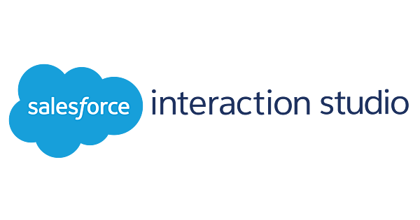

How Interaction Studio Stacks Up to Adobe
Day 1
Interaction Studio provides immediate personalization and easily integrates with Adobe, Google, or any wide variety of MarTech stacks
 | Interaction Studio | Adobe Target + AEP
Profiling | Create one unified profile | Separate profiles for users in each Adobe product
Data Collection | Collects time spent and engagement, views, clicks | Collects page views and clicks
Testing | Perform A/B testing on site | Perform A/B testing on site
Timing | Decisions and algorithms are executed in 20ms; real-time | Next-time personalization; requires 12-24 hour synch
Personalization | Individual automated personalization; 1:1 | Product recommendations are 1:many
Platform | Personalize any email at any open time. Synch with any email system | Can’t personalize for Marketo or Eloqua. Best used with Adobe products.
Ease of Use | Works well with non-technical and technical teams | Highly technical teams required to do more advanced personalization
Integrations | Easily integrate with Adobe, Salesforce, or most major MarTech platforms | Limited integrations outside Adobe
Notes:
Syed

Slide 22
Q&A
Notes:
Tags: agenda, list, time

Slide 23
Day 2:
Platform Deep Dive
Notes:
Tags: divider, left aligned header, divider with image

Slide 24
Use Case for Training Overview
Day 2
We will be using the following use case as an example of how the concepts on the following slides apply to a potential customer use case
Product Recommendations for eCommerce site
Types of Product Recs
Similar products
Cross sell up sell
Brand/Category specific products
Post purchase products
Industry: Retail
Activation Channel: Website
Campaign Type: Web
Features leveraged:
Enhancing the Product Rec Use Case
Can carry over the same recommendations to email channel
Can use previous purchase data to enhance recommendations
Can use site behavior, email preferences, etc. to further target
SFTP and Dataset Setup
IS Beacon
Sitemap
Data Layer
Catalog Setup
Unified Customer Profile
ETL
Promotions
Recipes
User Segments
Web campaigns
Web Template
Reporting
https://doc.evergage.com/display/EKB/Web+Content+Zone+Recommendations
https://doc.evergage.com/display/EKB/Retail+-+Web+Use+Cases
Notes:
Kalpana

Slide 25
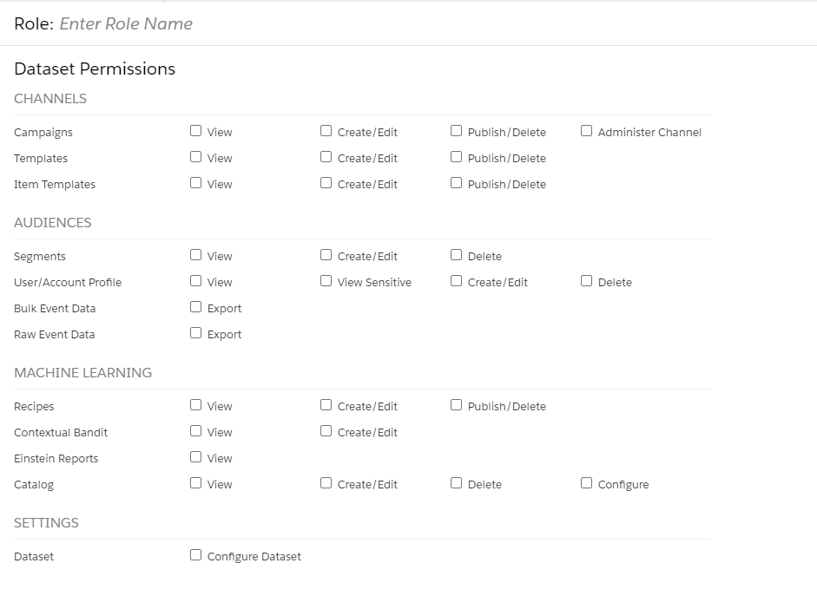
Accounts, Users, & Permissions
Demo Example:
We will set up a couple of users based on the use case: Campaign Editor for creating the web campaign and templates, Editor with Export- to set up segments and ETLs
Viewer- for testing, and Administrator- to provision user access
Day 2
Prior to starting any development work, you will want to ensure that you have set up roles and assigned them to the correct users based on business function/who will be working in the platform & what will they be doing. If you are working in IS through SFMC, you will want to confirm roles are correct in both platforms.
In Marketing Cloud…
Set up your existing SFMC users to have access to IS by providing them varying permissions under Setup > Users
In Interaction Studio…
Leverage OOB roles or set up custom roles by navigating to Security > Manage Role Definitions and creating varied roles with specific permissions (can only be done if you assigned Admin access in SFMC)
Assign the roles by navigating to Security>Manage Users> Selecting a User
The roles you assign can vary by dataset
https://share.vidyard.com/watch/rX1zKHzyWDwrX35PMGHVrH?
https://doc.evergage.com/display/EKB/Manage+Users
https://doc.evergage.com/display/EKB/Add%2C+Edit%2C+and+Delete+Users+and+Roles
Notes:
Kalpana

Slide 26
Dataset and SFTP Setup
Demo Example:
We will need 2 datasets, one Development and one Production since there will be two different environments (domains) of the site. We will need one SFTP user set up for each for Product Catalog file drop.
Day 2
Prior to starting any development, you will want to determine your dataset strategy and create the datasets. This is where your functionality will live. Then you will want to set up your SFTPs per dataset in the case of any ETLs or other integrations that require one.
Dataset Creation
Determine how many datasets you will need
SFTP Creation
SFTPs are leveraged to send and receive data
To create an SFTP user, navigate to Security> Manage SFTP Users
Each SFTP user can only be accessed through only one dataset
Username and Password will only be shown once the user has been created and cannot be accessed again, so make sure to SAVE the credentials
SFTP files can be accessed by navigating to Feeds>SFTP Files where the following files can be located
Failed, Inbound, outbound, processed, processing, testing
Multiple Datasets | Single Dataset
Multiple Domains Varying catalogs Multiple brands Ease of implementation Multiple locales/currencies For varying environments (i.e. Dev and Prod) | Single domain/locale/brand OR Consistent catalog across multiple domains Consistent key points of interaction across domains/locales/brands Require a holistic view of your customers across multiple domains/brands
Navigate to Manage Datasets in the Dataset dropdown menu to create your dataset
Under Settings > General Setup, you can select options applicable to your dataset based on business need, determine dataset type, and modify dataset label
NOTE: SFTP files will be deleted after 60 days from the date of upload.
https://share.vidyard.com/watch/k7Qg6uLPeUppG7antU8D6B?
https://share.vidyard.com/watch/TmCrgVPsCNRULBm3cqF9tx?
Notes:
Kalpana

Slide 27
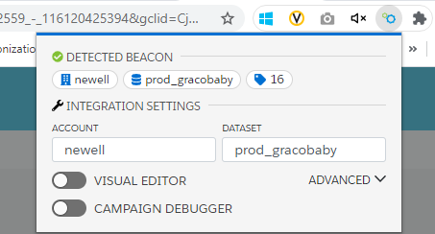
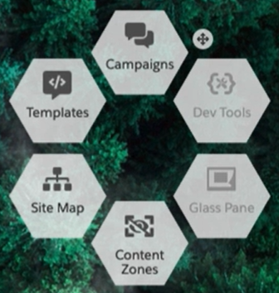
IS Beacon and Evergage Launcher
Demo Example:
We will use the Evergage Launcher to validate the beacon code has been placed on the site, and open the launcher to play with select content zones
Day 2
The IS Web SDK (Javascript beacon) will place a first party cookie on the visitor’s browser, which sends the data back to Interaction Studio
IS Beacon Code
IS beacon should be placed on the client website to collect and build profiles for each behavior
Will collect user behavior and send information back to IS for recommendations and personalization campaigns to qualified visitors
IS Beacon code handles:
Identity & Cookie Management
Sitemap for data collection
Beacon extensions for personalization templates and customer rendered campaigns
Performance monitoring
Synchronous (recommended) and asynchronous integration options
Evergage Launcher (Visual Editor & Campaign Debugger)
Chrome extension recommended for IS Development
Menu will sit in the corner of the page and allow you to edit, test, and debug
https://share.vidyard.com/watch/tCuW4tRaTvjM4xkuXiRVdr?
https://quip.com/jPHPAuwmnKGa/Interaction-Studio-Web-SDK-Beacon-Deployment-Options
https://share.vidyard.com/watch/WCBzAiHPfTaAPmG6MRrsp5?
Notes:
Akshay- Demo

Slide 28
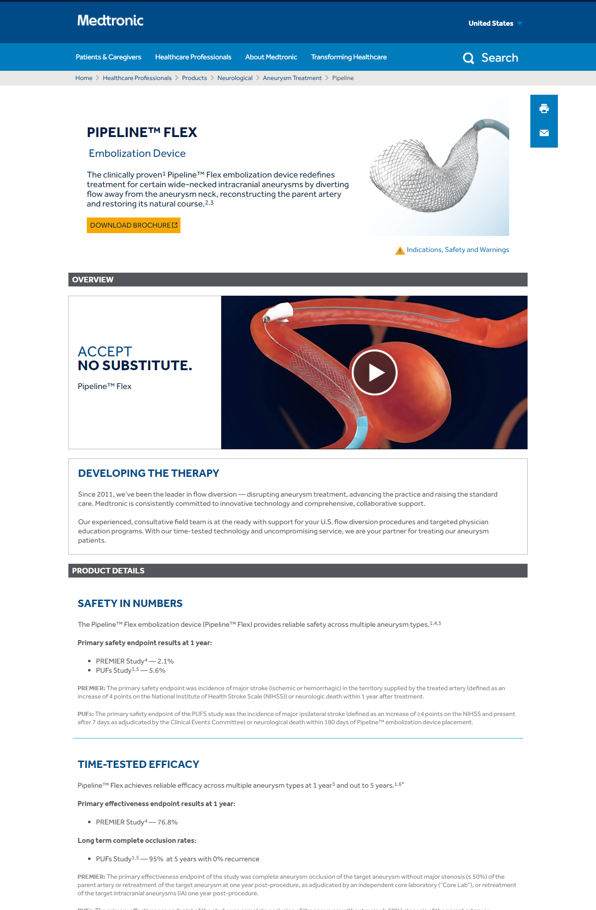
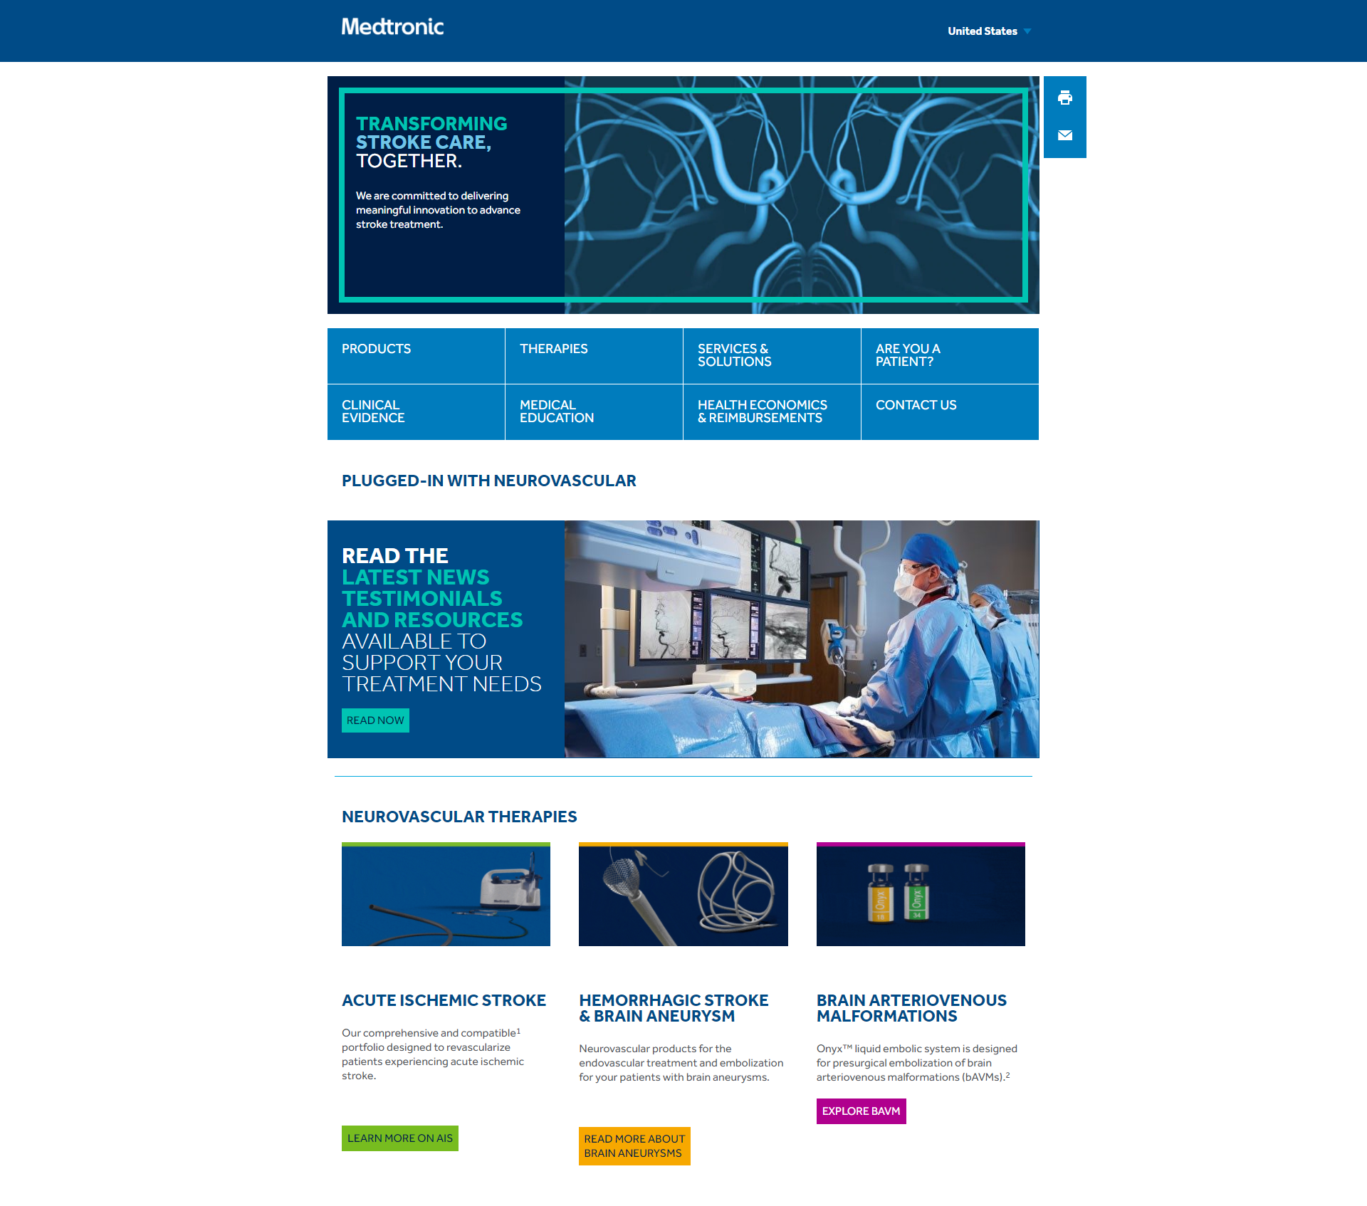
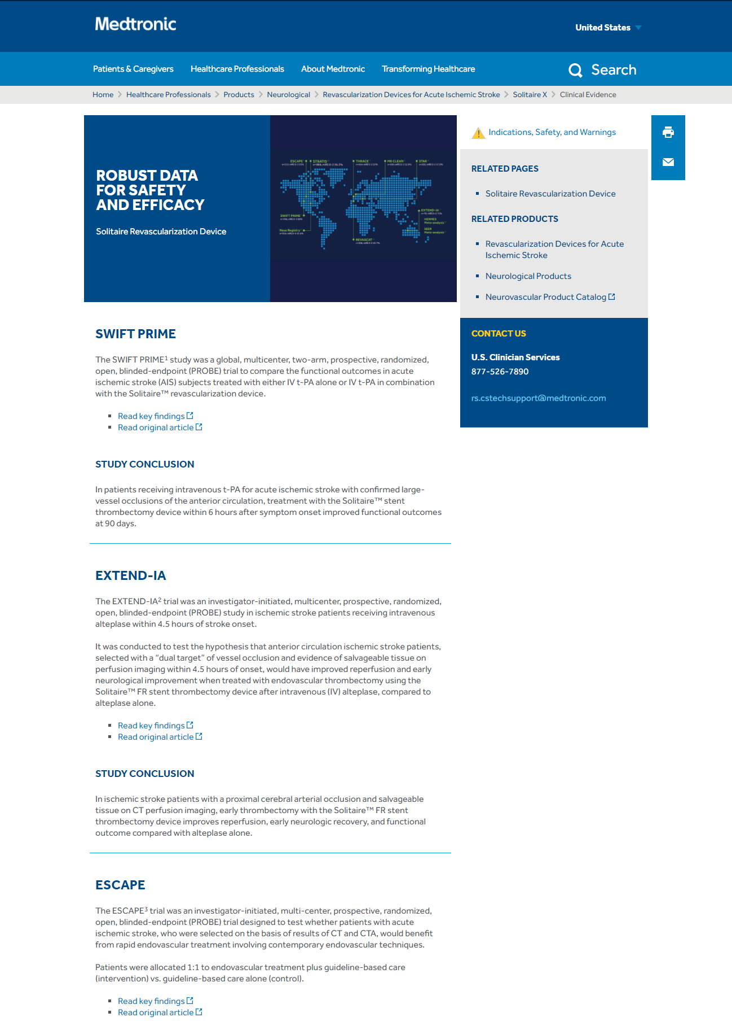
Site Mapping and Blueprint
Demo Example:
We will need to identify select pages for site mapping, and the events and user attributes we will be listening for to send to Interaction Studio
Day 2
The site map is an integration layer that’s built specifically for a client’s site, using Evergage APIs and written in JavaScript. Defining the sitemap is an integral part of discovery and will serve as the basis for development.
Elements of a Site Map Blueprint
Site map describes the structure of the site as the user interacts with it by executing within the Evergage Web SDK
Guides the platform’s understandings of each defined page type, event, and identifies valuable data such as:
What are the unique types of pages on the website?
What user interactions, or events, should the platform capture?
What other data should be scraped from the website?
The output of this information of discovery is the site mapping blueprint
The sitemap blueprint serves as the instructions and documentation for an Interaction Studio implementation
Page Type
Product Detail Pages
Home Page
Event
Downloads
Add to Cart
Page Views
Time Spent
User/Account Attributes
Profile Information
Subscriber ID
Form Completion
https://share.vidyard.com/watch/3FLuYbbWLmMnYAC86Vufbv?
https://share.vidyard.com/watch/12hM7chXdumN6BRkkK13bx?
https://quip.com/IblfAoIPCURi/TEMPLATE-Site-Mapping-Blueprint-eCommerce-Example
https://quip.com/4DJwAxzuDKbR/Sitemap-QA-Checklist-and-Best-Practices
https://developer.evergage.com/web-integration/sitemap/examples
Notes:
Kalpana

Slide 29
Site Mapping Examples
Demo Example:
We will use the sitemap to recognize if the page is a PDP, if the customer signs up for their account, if there exists a Product Recs Row content zone, capture catalog information such as SKU, and pass along any information on purchase.
Day 2
The site map is a configuration driven layer. The site map can be setup to support global config and page-type specific config.
PAGE TYPE CONFIG
Page type config
Identify pages that share a similar structure – the page type configs organize the sitemap code structure & logic executed by the SDK
Global config
If a page type config is defined, then it will merge with the global config
Ex: Global pop-ups, global infobars
Event listeners
Ex: Capturing a user’s last searched term
Ex: Capture data from small forms in the header or footer
isMatch
What unique identifiers were used to match this page?
Methods:
URL
DOM Element
Data Layer
Action
This is used for campaign targeting
Content Zones
Identify areas where campaigns will be inserted according to the client’s use cases
Catalog
Contains key items users can engage with.
(Products, content to promote, offers, etc.)
Listeners
Event listeners managed by the platform.
Bind and unbind as the matched page changes.
onAction Event
Update the event with any additional data before it is sent.
GLOBAL CONFIG (WITH PAGE TYPE)
Merging
Matched page config values are executed first
Content zone and listener arrays are concatenated
Content Zones
Global info-bar
Global Pop-up
Listeners
Email Submission
onAction Event
Email address collected
Locale
en_US
Notes:
Akshay- demo

Slide 30
Data Layer
https://share.vidyard.com/watch/3FLuYbbWLmMnYAC86Vufbv?
https://share.vidyard.com/watch/12hM7chXdumN6BRkkK13bx?
https://quip.com/IblfAoIPCURi/TEMPLATE-Site-Mapping-Blueprint-eCommerce-Example
https://quip.com/4DJwAxzuDKbR/Sitemap-QA-Checklist-and-Best-Practices
https://developer.evergage.com/web-integration/sitemap/examples
Quip
Mention Events/Actions
Day 2
Different perspectives on the data layer
Data layer contains key information that lives on the site, such as product or account related attributes. This information is updated in real-time.
A data layer is a javaScript Object, which sits in the middle, transfers visitor interaction data occurring at the user interactions to different vendors like analytics, personalization etc.
A data layer is the middle ware for the web. It provides a consolidated integration platform where all web based platforms can communicate with each other.
Functional Definition
Technical Definition
Executive Definition
Notes:
Kalpana
Akshay to show NTO Data Layer Object

Slide 31
Catalog Setup
Demo Example:
We will set up a product catalog with the primary item type as product and attributes and dimensions similar to those listed out in the first diagram.
Day 2
IS maintains a real time catalog that contains and organizes items and its related data. It can be used for personalization, targeting, and reporting and insights.
Product Example
Catalog can contain:
Items
Products
Content
Offers/Creative
Each Item can have
Attributes
Dimensions
Item 1
(i.e. jacket)
Item 2
(i.e. pants)
Attributes
(i.e. color, size)
Attributes
(i.e. color, size)
Dimensions
(i.e. category, gender)
Content Example
Catalog can be populated by:
Sitemap
Feed (Product ETL)
Article 1
(i.e. Blog post)
Article 2
(i.e. How to guide)
Attributes
(i.e. URL, Publish Date)
Attributes
(i.e. URL, Publish Date)
Best Practices
Use both the sitemap and the Feed (one as the primary source and the other as the secondary)
Determine dimensions carefully as it can help track customer affinity
Dimensions
(i.e. author, industry)
https://share.vidyard.com/watch/Zck6s8NgRmMJzKm8mWFsNv?
Notes:
Kalpana

Slide 32
Unified Customer Profile Setup
Demo Example:
Our UCP will have First Name, Last Name, Email Address, Phone Number, Contact ID. The identity attributes would be email address and Contact ID.
Day 2
The UCP provides a comprehensive, holistic view of every visitor, customer, or user based on their interactions across channels. The identity management system recognizes when multiple profiles belong to the same customer and merges the profiles and their corresponding data based on pre-determined configurations.
Customize the UCP by….
The Identity Attributes System…
Selecting your default customer overview screen type based on industry (SaaS, eCommerce, Demand Generation)
Creating custom attributes under Settings> Attributes
Selecting Type, Classification, and if an identity type
Can be populated from sitemap or User ETL
Determines if events/actions should be assigned to a new or existing profile
Should be set up at the start of any implementation to ensure all data is captured
Should include all unique identifiers across multiple platforms
Cannot be modified once set up
Should align with the definition of a individual customer
Should not include compounded values
Should consider Uniqueness, Case Sensitivity, Data Types
Consists of OOB Identity Types (do not duplicate)
Email Address, SFMC Contact Key, SF CRM Lead ID, SF CRM Contact ID, Customer ID
Leverage the UCP to determine…
Assumes appropriate availability of key business, IT and analytics stakeholders to weigh in on risk mitigation and issue troubleshooting plans
Assumes appropriate ability of key stakeholders to make timely decisions
https://share.vidyard.com/watch/ZdoxYdbFe7mTy3d4K5qF28?
https://share.vidyard.com/watch/da8ueaBgMWs9jFnEa4VJaU?
https://doc.evergage.com/display/EKB/Identity+Management
https://doc.evergage.com/display/EKB/Unified+Customer+Profile
Notes:
Kalpana

Slide 33
ETLs & Gears
Demo Example:
We will leverage the Product ETL to populate the catalog and the Transaction ETL to load any historical purchase data
Day 2
Interaction Studio ETLs, which is built on Gears, can be leveraged to extract data from one source, then transform and load it into Interaction Studio by way of the SFTP site. ETL data feeds have access to update the catalog, import and export segments, and load historical data.
Some of the types of ETLs available
Product ETL
User ETL
Account ETL
Transaction ETL
Category ETL
Manual Segment ETL
Data Normalization & Cleansing
Data Monitoring
User Data
Feed Generation
Identity Management
Account Data
Delta Feed Sequencing
Data Ingestion
Campaign Data
Key Callouts when setting up an ETL feed
There are limits to certain items based on ETL which can be found here
Recommend keeping the file under 5GB
All files should be CSV format with specific requirements here
Guardian system can be leveraged to send notifications when the file meets a customizable error threshold
Auditing/Monitoring/Logging
Interaction Studio Feeds Dashboard
https://share.vidyard.com/watch/YGhsnAekiW2XDtAfFSqMZh?
https://share.vidyard.com/watch/T3M8oLRXNkuti57JZwu4J3?
https://doc.evergage.com/display/EKB/ETL+Overview
Notes:
Akshay- Demo

Slide 34
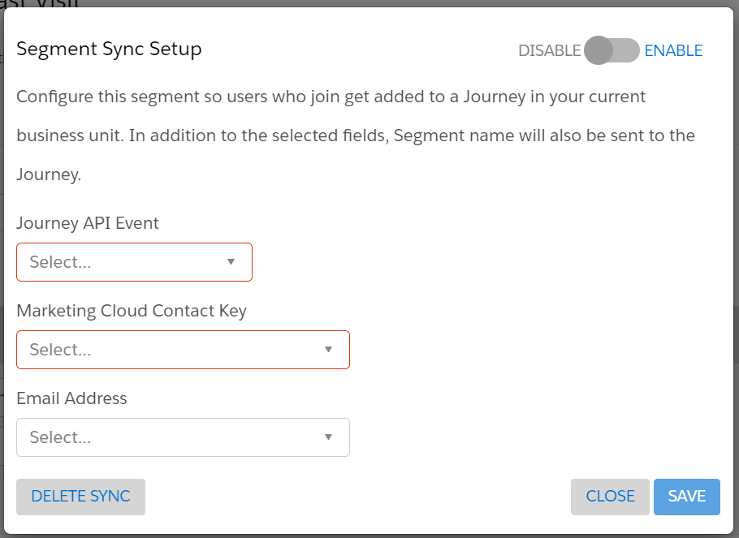
Integrations
Demo Example:
We will not need to leverage either integration unless we wanted to expand our recommendations to other channels
Day 2
You can use segments to add customers to Journey Builder Journeys within moments of the data changing.
Journey Builder Integration
Salesforce Integration
Once you create a segment in Interaction Studio, you can select Sync to Other Systems and AddToJourneyBuilderOnJoin & then populate the following details
Must install the Interaction Studio Connected App. Pass along customer decisioning data such as Next Best Offer to Sales/Service Cloud
Callouts
Will only work if a customer performs an action (will not work if they did NOT do something)
Will qualify everyone, but only known users will be injected into the journey
Can only send segment name and MC Contact Key and Email
If there’s not high traffic on the dataset (i.e. Dev environment) can expect inconsistencies with qualification as it needs to be “warmed”
Callouts
Must have Interaction Studio Premium
Dataset with Catalog items and/or Promotions
Administrative permissions to both Sales/Service Cloud and Interaction Studio
Recipes built, if you want to recommend items
At least one configured Einstein Decisions Feature Subset, if you want to recommend promotions
https://share.vidyard.com/watch/zg6fbduR1KByFuivQTMoeA?
https://doc.evergage.com/display/EKB/Send+a+User+to+Journey+Builder+Upon+Segment+Join
https://doc.evergage.com/display/EKB/Understand+Salesforce+and+Interaction+Studio+Integrations
https://share.vidyard.com/watch/Tjj6MzjXMweiFXCvJcyyg3?
Notes:
Kalpana

Slide 35
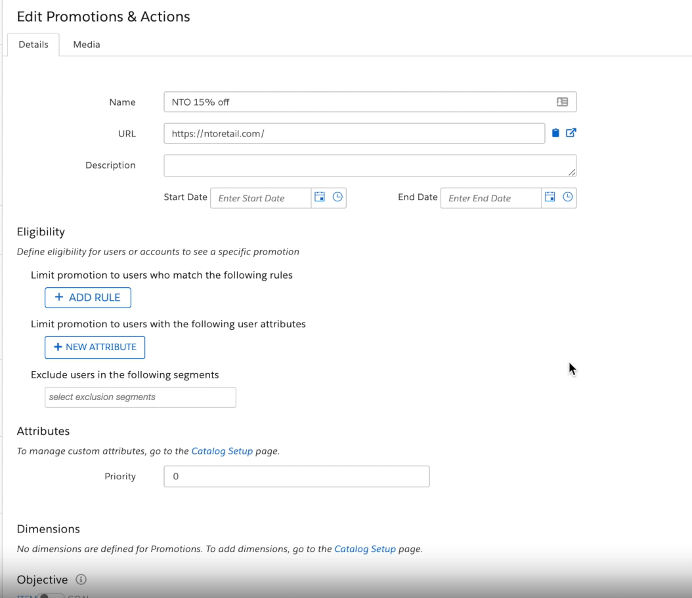
Promotions Setup
Demo Example:
For our specific use case, we will not need to leverage promotions but if we were trying to recommend a different offer instead of products, we would use this
Day 2
The Interaction Studio Catalog can be used to prioritize decisions around the next-best-action for each individual. Promotions can be used in conjunction with Einstein Decisions (machine learning) to determine which promotion, offer, or next best action the customer should see.
Promotions can…
Be events, Offers, Discounts, etc.
Be tied to specific content zones to control where it can be displayed
Store multiple media types
Be loaded through the Promotion ETL
Have specific eligibility or user attribute rules
Have specific attributes or dimensions defined in the catalog set up
Be leveraged in any type of campaign
https://share.vidyard.com/watch/t5VivKndxQJsBTzngVaCEZ?
https://doc.evergage.com/display/EKB/Promotions
Notes:
Akshay - Demo

Slide 36



Recipes & Decisions Setup
Demo Example:
We will use the recipes and Contextual Bandit System to determine what type of products are recommended.
Day 2
Interaction Studio's Einstein machine learning-powered algorithms called Einstein Recipes present unique product and content suggestions to individual visitors.
Action
Learn
Base Algorithms
Select one or more base algorithms
Deliver the best experience
to a user
Take the customer’s response to the experience and add it to the training data set
Contextual Bandit Continuous Learning Cycle
Filters
Apply filters to include or exclude specific variables
Add personalization based on user’s affinity towards a specific dimension
Boosters
Variations
Force variety into your product recommendation results
Decide
Take everything we know about a user and compare it against all the users that have come before them to ﬁnd the highest value action
Comparison of SF’s Einstein products
https://share.vidyard.com/watch/peptFD4jZaP4F4MujKyS4P?
https://share.vidyard.com/watch/XDv2sDR4ANP6JaD1gSifRx?
https://share.vidyard.com/watch/T5X626STyuaeVbUiRzAXnF?
https://share.vidyard.com/watch/1g3uFSeuY8V5F3EwM3n2q1?
https://doc.evergage.com/display/EKB/Einstein+Recipes
Notes:
Akshay- Demo (NWL account)

Slide 37
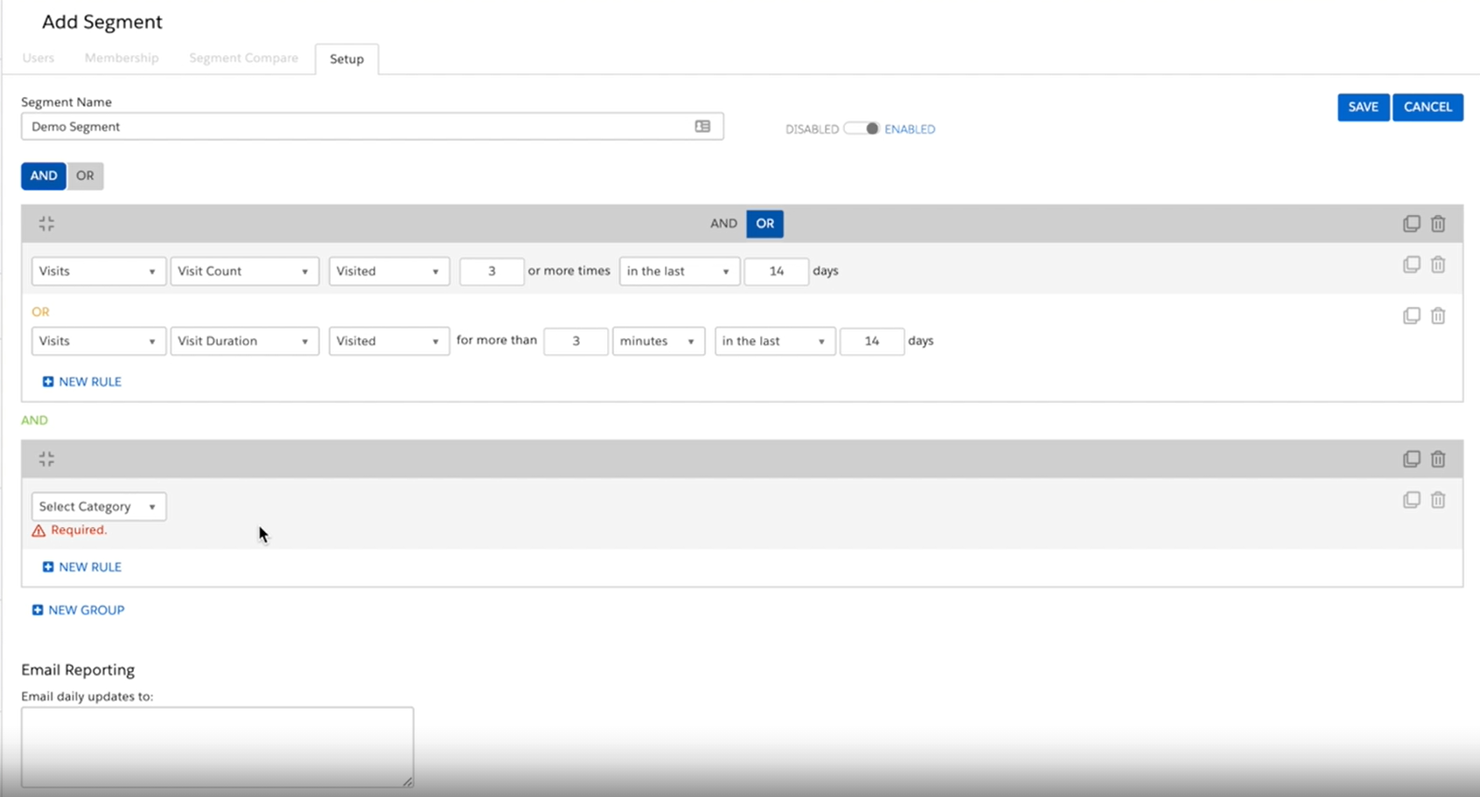
User Segments
Demo Example:
We will create a segment to target users who have purchased from the site in the last 30 days and have an account to specifically target customers who are committed to the brand
Day 2
An Interaction Studio segment is a real-time grouping of accounts or individuals based on a set of criteria you define. Segment updates happen in real-time, so any membership changes occur immediately, even during the same visit.
Segments can be created based on…
Custom Attributes
a Specific Action Count
User Location
Third Party Integrations
B2B Detect Data
With segments you can…
A/B Test
Analyze Segment Details
Compare performance to other segments
Identify Segment Membership for a User or Account
Clone a Segment
Use them to determine the audience for a campaign
Send customers to a Journey in SFMC
Export using Segment Exporter Gear
https://share.vidyard.com/watch/iYHK2SCNR9ZKhbfZkkjDgM?
https://doc.evergage.com/display/EKB/Audiences
Notes:
Akshay- Demo

Slide 38
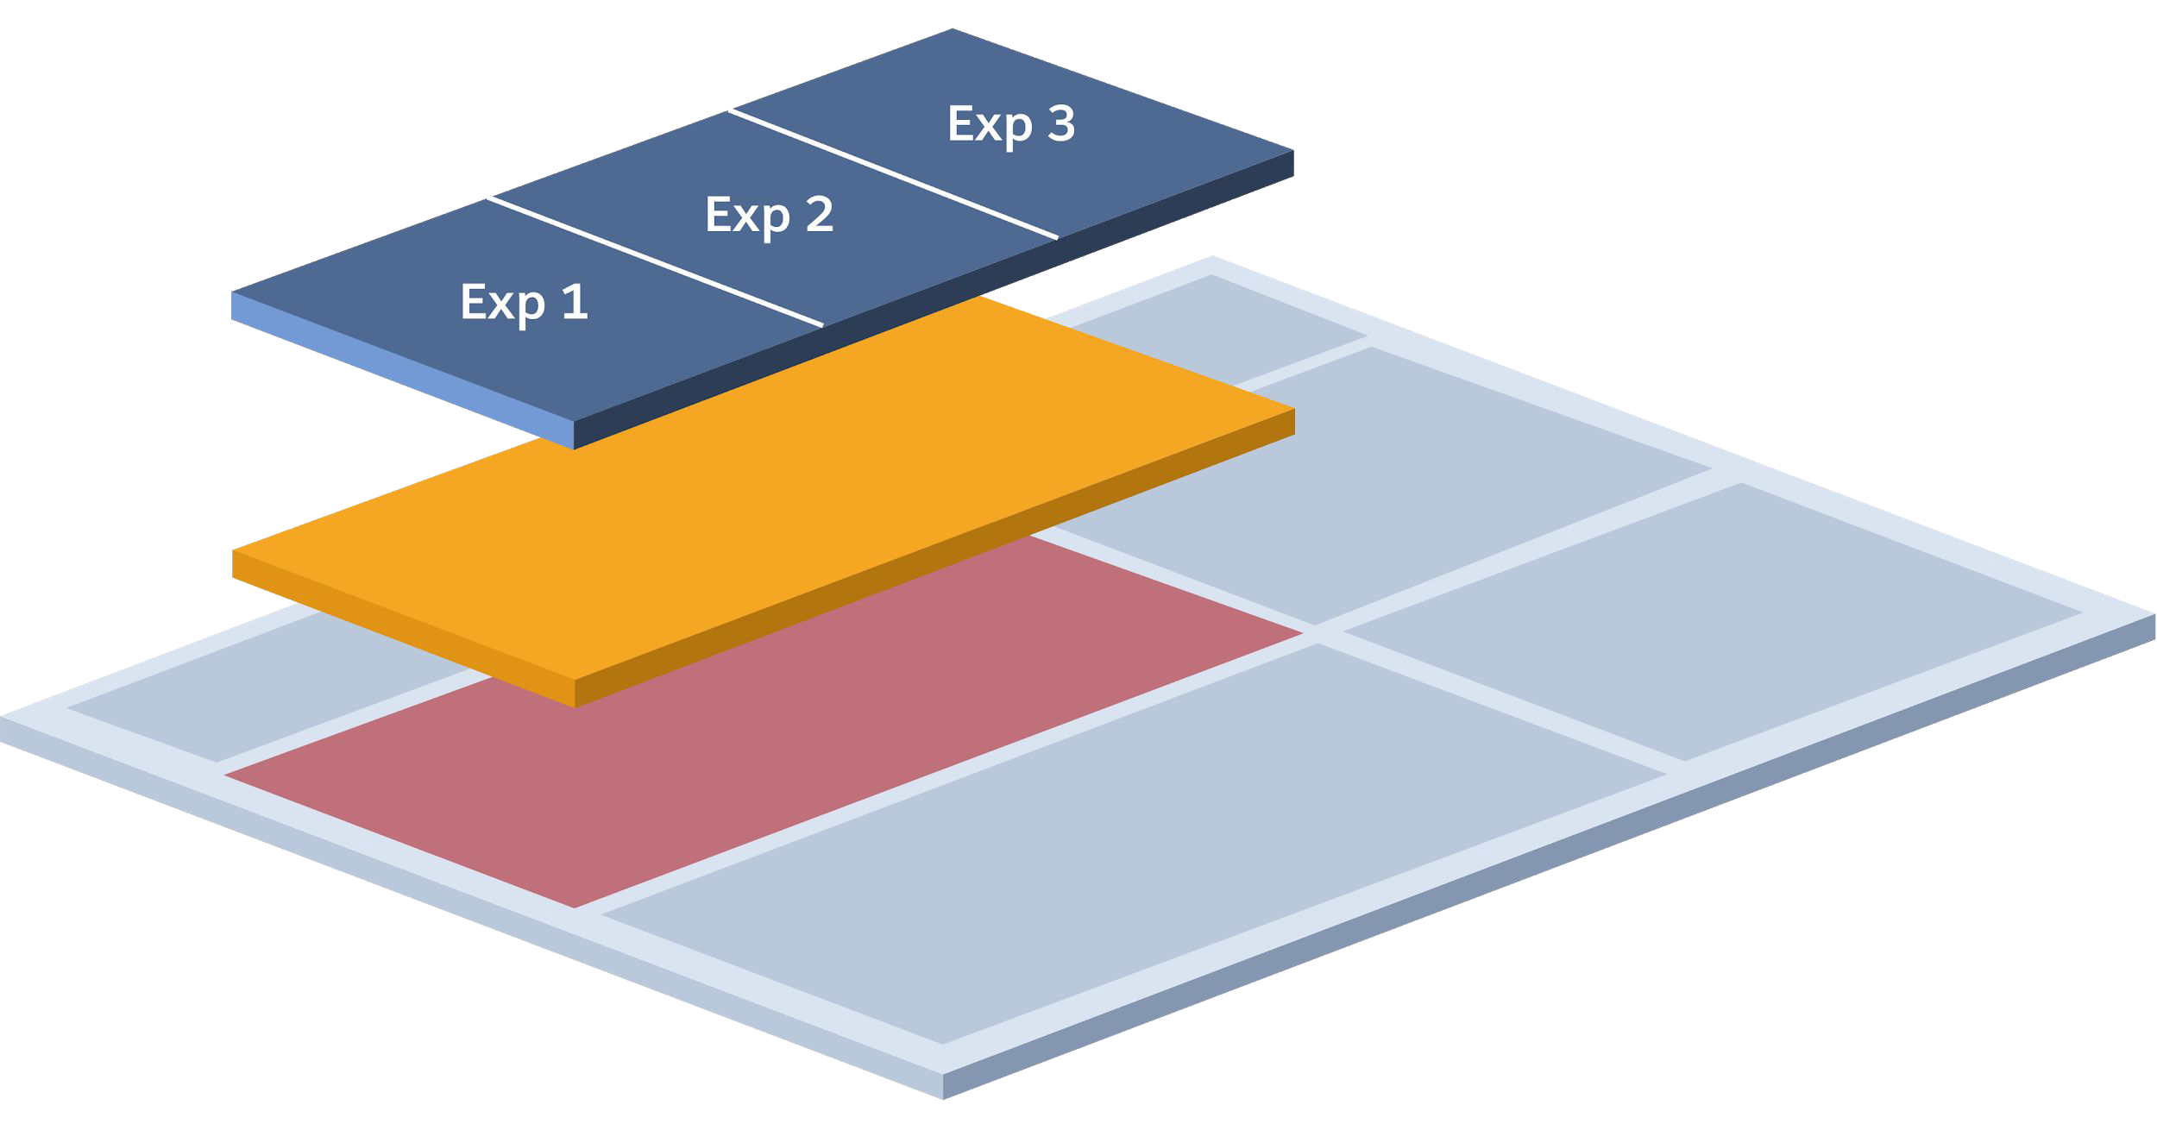
Web Campaigns and Experiences
Demo Example:
We will create a web campaign called Previous Purchas Product Recs leveraging the template PDP Recs Bar and the Content zone PDP Recs Row.
Day 2
Web Campaigns are created by a business user with campaign editor or higher permissions using a web campaign template created by a developer.
Campaign:
The only piece of the puzzle that a business user touches.
When a business user creates a new campaign, they select a template, complete the inputs available to them, & then publish the campaign. The published campaign is visible to prospects/customers that qualify basead on the testing/targeting logic
Content Zone:
An area on the site that a developer has mapped to make it eligible for personalization
Content Zone Examples:
PDP Recs Row
Home Page Hero
Template:
Fully QA’d & built conﬁgurations that a business user can leverage inside of a campaign.
Templates deﬁne what a campaign can render (ie. promotional asset, product recs, etc.) & what the business users can edit (ie. Algorithm, Message text, CTA text, etc.)
Template Examples:
Email Capture Pop-Up
PDP Recs Bar
Infobar - Single CTA
Homepage Hero - Contextual Bandit
Campaign
Template Content Zone
https://share.vidyard.com/watch/KhVXhbKNeD22cYUd3AM7xK?
https://share.vidyard.com/watch/9FmynA42bUgnZ5iUoC2ked?
Notes:
Kalpana

Slide 39
Web Template Development
Demo Example:
For our use case, we will be leveraging the Einstein Product Recommendations Global Template
Day 2
A template offers a developer-built, fully QA'ed, repeatable framework that you can use to create personalization campaigns. Templates define what a campaign can render, such as promotional assets, product recommendations, copy, and images along with what business users can edit such as the algorithms powering the recommendations, message copy, and CTA copy.
Template Build Checklist
Campaign Stats Tracking
Deferred rendering
Zero Flicker Compatibility
Accessibility Standards
Cross Browser Compatibility
Components of a web template
Serverside code
What content will be returned to the client?
Language: Typescript
Handlebars
How is the content I am rendering structured on the web?
Language: Templated HTML
CSS
What styles will I apply to the content I am going to render?
Language: CSS
Clientside Code
How is my content going to render on the page?
Language: JavaScript
Global Templates available in IS
Banner with Call-To-Action
Exit Intent with Email Capture
Infobar with Call-To-Action
Redirect
Infobar with User Attribute & Call-To-Action
Slide-In with Call-To-Action
Einstein Product Recommendations
Einstein Content Recommendations
Google Analytics Segment Push
Exit Intent
https://quip.com/AVYVA9wCxblH
https://developer.evergage.com/campaign-development/web-templates
Notes:
Akshay- Demo

Slide 40
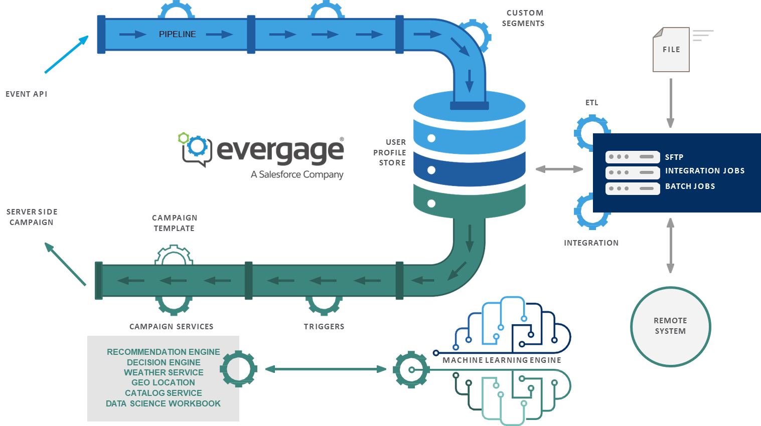
Event API + Server-Side Campaigns
Demo Example:
We will not need to leverage the Event API or Server Side campaigns
Day 2
The Event API allows real time data sharing from a channel where IS SDK is not present. Server-side campaigns gives you the ability to integrate Interaction Studio testing and personalization at the server to server level. They pull decisions and data from IS into any external systems.
Event API can be used with
Sales cloud/Service cloud
Call center application
Server-side web
POS
An Event can
Contain User, Account, Source, or Conversion data
Leverages token-based authentication
Components of a
Server-Side Campaign response
Attributes
Segment membership
Recs
Next Best Offer or Action
https://share.vidyard.com/watch/wpaXtSPx9ZSxNNpvta8xHh?
https://share.vidyard.com/watch/bymr8EUdEmjMrA5RJveqZJ?
https://doc.evergage.com/display/EKB/Server-Side+Campaigns
https://developer.evergage.com/event-api
Notes:
Syed

Slide 41



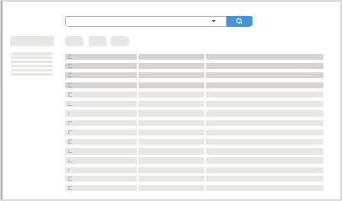
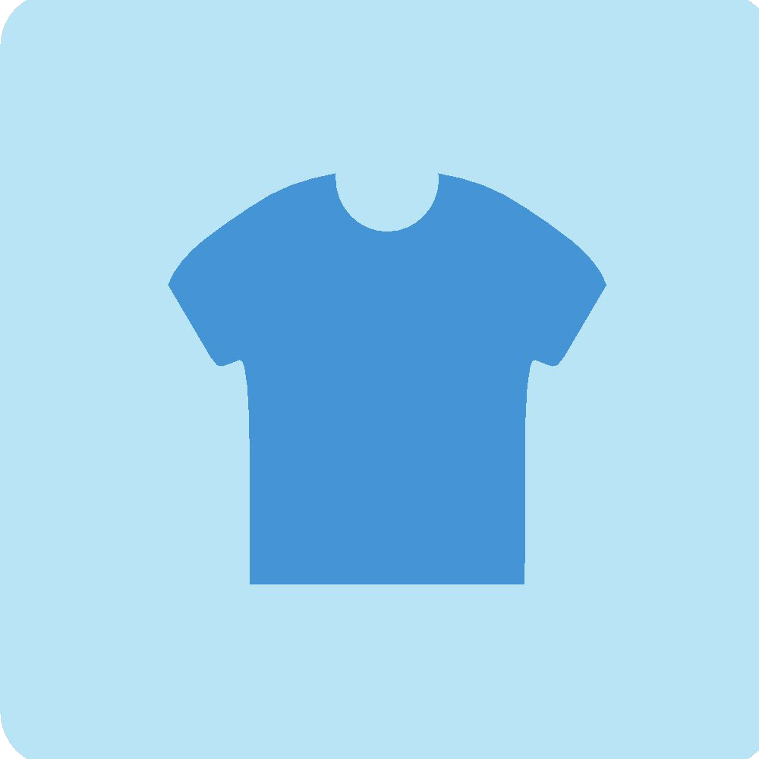
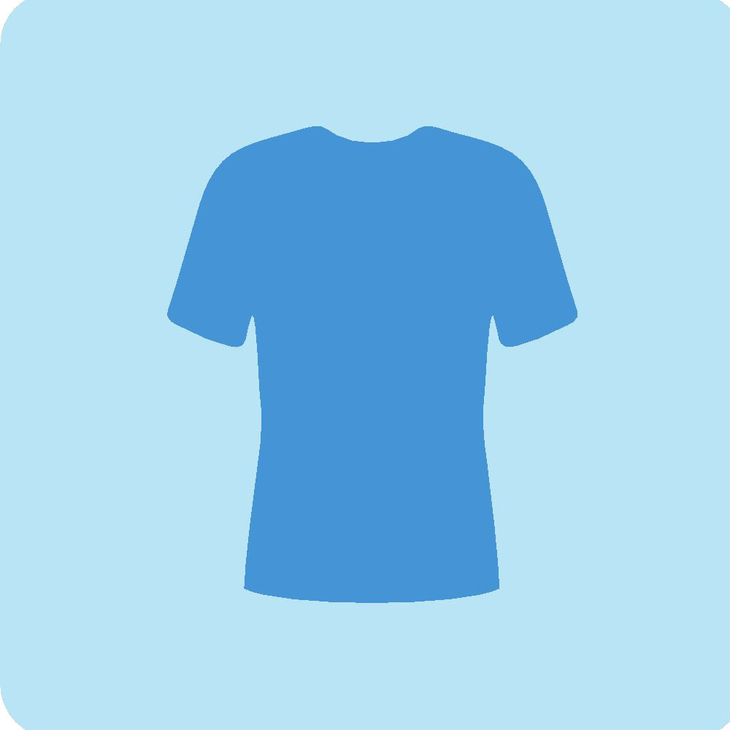


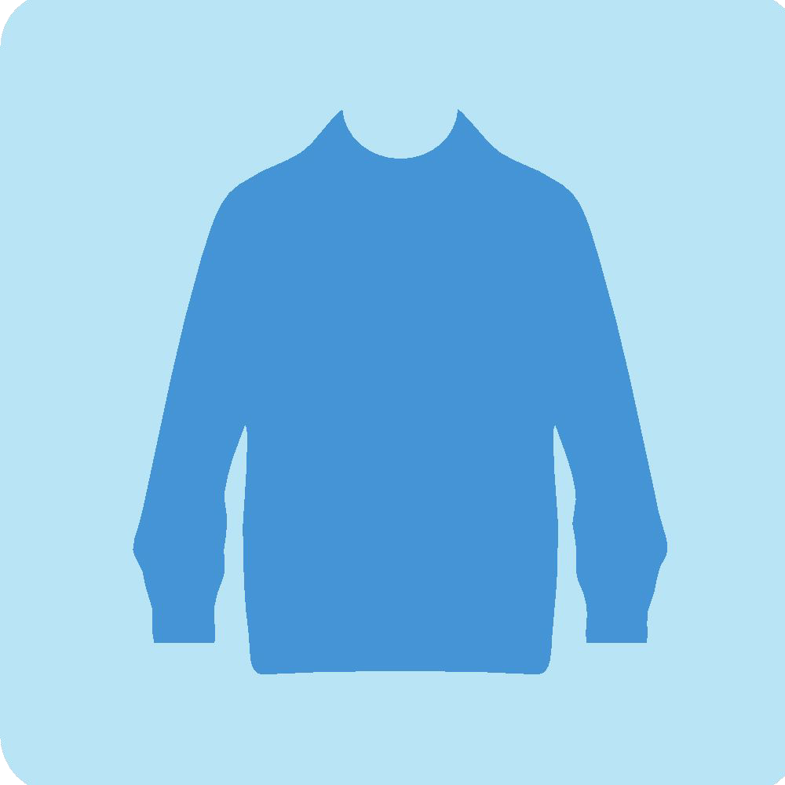
Open Time Email Recommendations
Demo Example:
Since the activation channel for our use case is web, we will not need to leverage Open Time Email Recommendations
Day 2
A block of HTML code that can be placed directly into a greater HTML template to create a personalized experience in any email. Rendered in true real time, utilizing the most current and up to date information of every user in your subscriber list.
1
Your email marketing team sends an email via ESP/MAP
2
Customer opens your email in their email client
3
Interaction Studio determines what products / content to display
4
Email client renders a 1-to-1 personalized, relevant email
Open Time
2 Ways to Build Open Time Email Recs
Promotions & Actions
Individual content images that are shown to users through the “Promotions & Actions” system
Additionally, by labeling each piece of creative with a “Content Zone”, you’re then able to group content together for dynamic rendering
Open Time Item Templates
The combination of image, name, brand, price, etc that makes up an individual content block of 1 product/blog post/etc, this utilizes an established catalog already in the system
The personalized selection of Product/Blog Post/etc shown is determined by a “Recipe”
https://share.vidyard.com/watch/5qB8tBrcisXJ1ZpuoD5GWZ?
https://doc.evergage.com/display/EKB/Create+an+Open-Time+Email+Campaign
Notes:
Kalpana

Slide 42
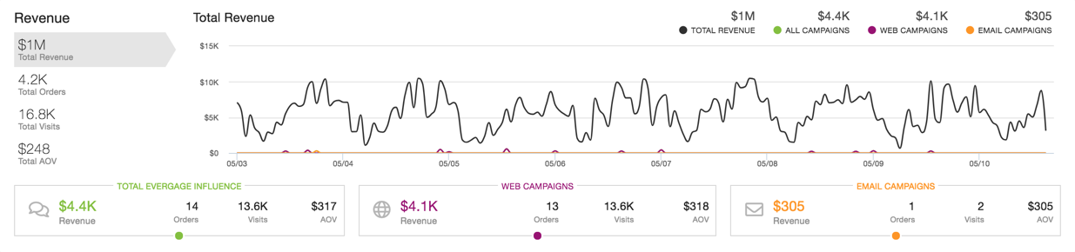
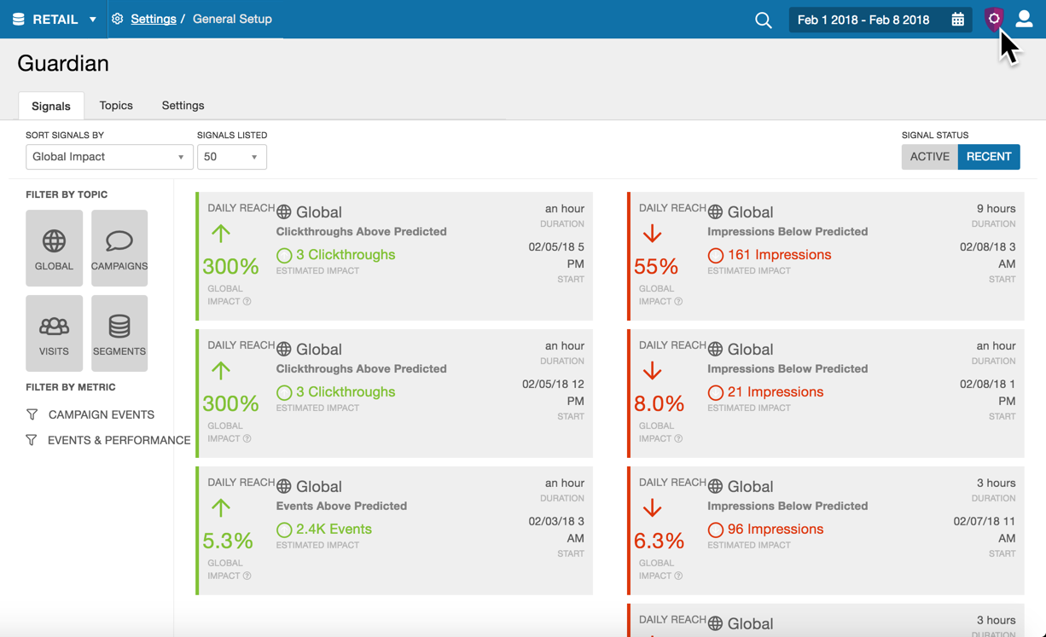
Reporting
Demo Example:
Once the campaign is published, we can leverage the Campaign Statistics report to see how effective it is and enable the Guardian system to ensure success of ETLs
Day 2
Once you have determined what and how to personalize your site, Interaction Studio reports will help you determine what’s working and where improvements can be made
Types Of Reports Available
Reports Dashboard- depending on your industry or function, the Reports Dashboard will have different sections.
Activity Reports- variety of metrics tracked on your site - recent visitors, paths these visitors take on site, actions they perform while visiting
Results Reports- Allows you to measure how your campaign is performing and calculate attribution for goal completion
Visits Reports- include metrics on visitor Behavior, Technology, and Referring Sources.
Guardian
Continuously monitors thousands of metrics from all your properties to identify opportunities for optimization and potential issues that could affect other parts of the platforms (need to contact Support to have this enabled)
Within each Guardian Topic, there are several metrics specific to that topic. Within each Metric, you may see one or more Signals (or none at all) depending on what Guardian detects for your site
Topic Examples: campaigns, visitor groups, global goals, device types
Metric Examples: Average order value, clickthroughs
Signal Examples: anything detected outside of normal activity
https://share.vidyard.com/watch/zHiWeyjmtDpqkNkhi6GuDH?
https://share.vidyard.com/watch/KPvgjAbLAcktbdsKKPZrjJ?
https://share.vidyard.com/watch/rSVqp4wWC6PCXT1SFboksb?
https://doc.evergage.com/display/EKB/Reports+and+Analytics
Notes:
Kalpana (if time, demo dashboards) – diff industries

Slide 43
Key Learnings
Day 2
The following lists out some key learnings from ongoing or completed implementations of Interaction Studio at many of our clients.
Discovery and Implementation
Focus on setting up the foundations of the platform across all potential channels so that use case activation can be quick
Site mapping can be done in broad strokes; aligning on page types and events does not have to get super specific and can be setup to support future potential use cases
Platform and Feature Level
Segment rules do not support date range
Products that are not viewed on the site do not show up in Catalog UI but are available in system.
Dimensions for products that are not viewed cannot be leveraged in creating segments.
Cannot do contain function in segmentation
Multiple goals can be configured for a single campaign, but once a customer meets a goal, they will no longer qualify for the campaign.
Subcat fields can only be used for segmentation but cannot be tagged as a dimension for the category item type and to help build affinity.
Cannot do mass data deletion from within the UI
Max number of user attributes per dataset is 100
IE 11 is not supported with existing sitemap
Notes:
Meredith & Kalpana

Slide 44
Additional Resources
Day 2
To learn more about Interaction Studio (Evergage) or access other useful resources for your pursuits or client engagements, please visit the following.
Resource | Description
www.doc.evergage.com | For in depth documentation on various parts of the platform, use cases, upcoming features, retired features, etc. provided by Salesforce
www.developer.evergage.com | For additional technical documentation provided by Salesforce
MT&I RT Orchestration Platforms Channel (linked) | Documentation leveraged at other clients, pursuit materials, training materials from prior Salesforce trainings, etc. Please use this channel to ask any questions that you may encounter
Implementation Guide (linked) | Deep dive of materials that were covered during this presentation with additional documentation and videos by Salesforce Password for all videos is Salesforce

Slide 45
Thank You.

Slide 46
Appendix
Notes:
Tags: divider, left aligned header, divider with image

Slide 47
Key Terms (1/3)
Day 2
Review below a list of Interaction Studio key terms as a foundational component to the training.
Implementation & Sitemapping
Catalog | Collection of business context reflected in Interaction Studio as a “shadow” catalog. Catalogs are comprised of catalog objects which are key items a user can engage with.
Catalog Attributes | Characteristics of an item that describe the item or belong to the item. Attributes can be used in campaigns to dynamically populate information about the item.
Dimensions | Contextual characteristics of an item that describe how it relates to other items & other items types. Dimensions differ from attributes because users can build affinity toward dimensions, stored in their profile, based on interactions with items which have those dimensions.
Events | Tracked user behavior on a website and are defined during the Site Map implementation. Events track key points of interaction on a website, such as form sills, add to cart, or clicking a CTA button. Events are stored on the User’s profile.
Site Map | Code executed by Interaction Studio’s JavaScript Web SDK (Beacon) on a website.
https://rise.articulate.com/share/91pz5M6b-wR3i8vPQGSlrLORaZwWzqJB#/
https://doc.evergage.com/display/EKB/Glossary

Slide 48
Key Terms (2/3)
Day 2
Review below a list of Interaction Studio key terms as a foundational component to the training.
User & Identity
Attributes | Characteristics of an item that describe the item or belong to the item. Attributes can be used in campaigns to dynamically populate information about the item.
Identity Attribute | Special types of attributes which are designated as Identifiers in your Interaction Studio dataset.
Profile Stitching | The process of merging two United Customer Profiles within your Interaction Studio dataset. Combine the data present in both profiles and will overwrite attributes to preserve the most recent attributes.
Unified Customer Profile | Provides a comprehensive, holistic view of users in Interaction Studio. It stores user attributes (e.g., affinity, visit history, segment membership) and can be used to target campaigns.
Data Feeds
Catalog Feed | Integrate data from an external system into the IS catalog. Important to make sure the catalog data ingestion strategy accounts for both data captured on the website and via the ETL feed.
Channel Engagement Feed | An integration that brings in engagement data from an external marketing campaigns, typically email campaigns. This data is tracked in a user’s profile and can be used for segmentation or campaign targeting.
ETL | Extract, Transform, Load are the mechanism Interaction Studio uses to ingest data feeds.
Transaction Feeds | Integrate transactions or conversion data into a user’s profile. Typically used when conversions occur outside the website, such as through a call center or in a physical brand/store.
Use Feed | Integrate data from an external system into a user’s profile. Often includes identity attributes such as email address or CRM ID, which can be used to match feed data to user profile created on the website.
https://rise.articulate.com/share/91pz5M6b-wR3i8vPQGSlrLORaZwWzqJB#/
https://doc.evergage.com/display/EKB/Glossary

Slide 49
Key Terms (3/3)
Day 2
Review below a list of Interaction Studio key terms as a foundational component to the training.
Web & Email Campaigns
Campaign | Business-user configurable personalization change made up of 1 of many Experiences Campaigns in Interaction Studio can be in web, email, or any other channels you connect to IS.
Campaign Type | Either be set up as A/B Tests, which randomly assign traffic between experiences and the control at the user-defined percentages, or Rule Based Tests, which qualify users for the experience based on the targeting rules.
Content Zone | An area of your site or email that a developer has configured to make it targetable for personalization campaigns. Defined during Site Map implementation and reference specific page source code selectors.
Einstein Recipes | Collection of AI Algorithms, Business Rules, Affinity Booster, and Variations that power personalized recommendation campaigns.
Experience | Individual personalization experiences delivered by Interaction Studio, such as bounce-prevention popup, a free-shipping inforbar or a personalized recommendations in email. Experiences can be tested against each other, or against a control (default) experience,
Segment | Groups of users who have/have not taken specific actions, behaviors, have specific affinities/attributes in their Customer Profile. Comprised of one or many clauses and can be set up to use AND & OR clauses.
Web Template | Developer-built, fully QA’ed, repeatable frameworks used to create web personalization campaigns.
https://rise.articulate.com/share/91pz5M6b-wR3i8vPQGSlrLORaZwWzqJB#/
https://doc.evergage.com/display/EKB/Glossary

Slide 50
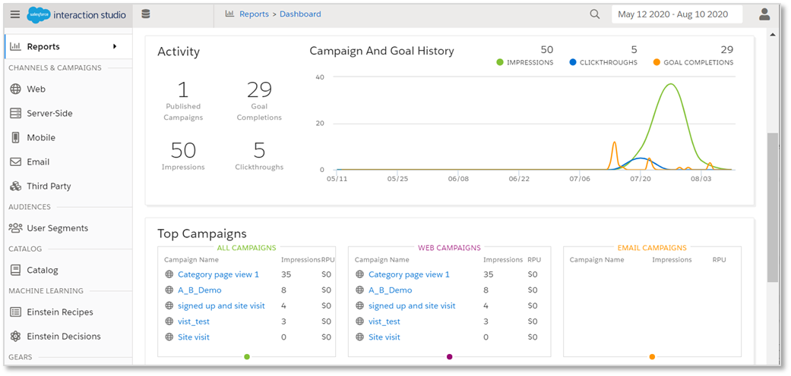
Key Features and Benefits of Interaction Studio
Interaction Studio helps marketers optimize real-time decisioning and activation across the customer journey.
Interaction Studio Features:
Multi Channel Behavioral Listening
Real Time Segmentation & Triggers
Real Time Multi-Channel Message Orchestration
Web Content Personalization
Product Recommendations (web / email)
Web A/B/n Testing & Optimization
Open Time Email Personalization
Reporting and Lifecycle Analytics
Key benefits include:
18% Increase in Conversion Rates*
20% Improvement in Customer Retention*
Shorten Time to Market
9% Increase in Offer Redemption*
Enhance Customer Experiences
10% Reduction in Cost to Serve*
Salesforce acquired Evergage technologies in March 2020 with the intent of using Evergage as a foundation for their Interaction Studio product (previously built on Thunderhead). This re-platforming will significantly expand Interaction Studio capabilities and is launching as Interaction Studio 2.0 in October 2020.
*These are illustrative examples of benefits realized by Interaction Studio clients

Slide 51
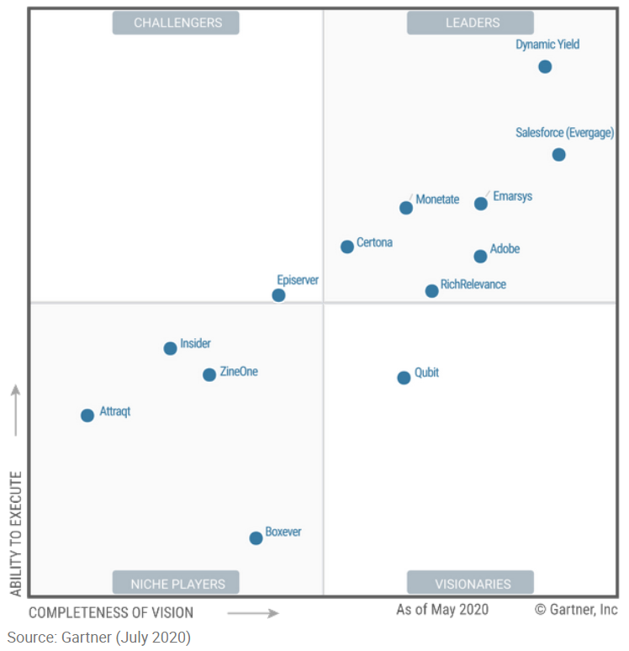
What Makes Interaction Studio Different?
With the acquisition of Evergage into the platform, Interaction Studio is recognized as a market leading personalization engine.
Recognized Leader by Gartner ¹
Key Differentiators ¹
Granular Audience Optimization: through the use of Interaction Studio’s customizable “contextual bandit” algorithms, marketers are able to generate finer-grained optimizations for smaller audiences over time.
Customizable Audience Alerts: Easy to configure alerts and notifications that allow marketers to evaluate granular segment-level personalization opportunities across all active campaigns.
Data Science Support: A new data science workbench, an expanded analytics schema, and easy to configure algorithm recipes enable citizen data scientists to get the most out of their customer data.
Real-Time Decisioning: real time listening of visitor clicks, scroll depth, dwell time and cursor behavior to create a more complete user profile that can be used for real-time triggering and personalization.
Real-Time Analytics: In addition to the real-time decisioning engine, Interaction Studio generates several data streams and analytic reports on the fly to help monitor customer behaviors and trends in real-time.
¹ Gartner’s “Magic Quadrant for Personalization Engines, 2020 report

Slide 52



How Interaction Studio fits into MarTech stacks
DATA
DECISION
DELIVERY
DATA MANAGEMENT
DATA STORAGE
BUSINESS
INTELLIGENCE
DATA SCIENCE
PLANNING
DESIGN
Customer Data Platform
ETL/ELT Orchestration
Data Lake
Ad-hoc Reporting
Segmentation
Affinity Analysis
Market Mix Modeling
Project Management
Workflows & Approval
Personalization
Conversion Rate Optimization
Data Hygiene
Identity Resolution
Data Warehouse
Attribution
Dashboards
Multi-touch Attribution
Propensity Modeling
Metadata Creation
Budgeting
Experience Management
DAM
Semantic Data Model
Consent / Preference
Cloud / Serverless
MRM
KPI / Metric Planning
Dynamic Creative Optimization
Tag
Management
Sentiment Analysis
KPI / CPI Measurement
Econometric Modeling
Next Best Action
Governance
CIAM
Archive
Suppressions
Journey Analytics
Lookalike
Churn analysis
ACTIVATION
DATA SOURCES
DMP
PAID
Ad Server
SEO
EARNED
Lead Management
CMS
OWNED
Marketing Automation
Interaction
Transactional
Behavioral
Sales
Campaign Analytics
Channel Analytics
Reactivation
Customer Lifetime Value
DSP / SSP
Bid Management
Social Media Activation
Product Reviews
Email
CRM / Loyalty
Prospect
Customer
Orchestration
Audience
Demographic
Operational
Service
Market Basket Analysis
Optimization
Response Modeling
Forecasting
Paid Search
Onboarder
Event Management
Communities
Mobile / SMS
Offer Management
WALLED GARDENS
EXPERIENCE CHANNELS
Google
Facebook
Amazon Media
Mobile
Email
Social
Display
Call Center
POS
IoT
Website
Capabilities supported by Interaction Studio

